Slide 1
Several CrewAI experimental projects

Slide 2
1. Technology investigation
repo:https://github.com/zizhec/crewai_samples/blob/main/tech_investigation.py
This is the vanilla tech investigation proj.
It has
two agents: researcher, reporter
two tasks:research, report
And it generates a report for the tech which is the input.

Slide 3
2. Improved tech investigation
repo: https://github.com/zizhec/crewai_samples/blob/main/tech_investigation_v2.py
The purpose:
Find out popular repos of this tech on github
Do research on this tech on search-engine
Compose results as a table with info from github and search-engine
Make the result a table
Appropriate agents and tasks are composed
Tools: github-tool and search-engine-tool are provided
Result:
I run out of time debugging the github-tool.

Slide 4
3. Improved tech investigation v3
repo: https://github.com/zizhec/crewai_samples/blob/main/tech_investigation_v3.py
Now that github-tool is not running yet, I had to use search-engine only.
But serper also ran out of quota, so I had to use free service: duckduckgo.
And I had to remove the repo research from the report.
Agents and tasks:
researcher(find solutions, with search-tool)
analyst(do research for each solution, with search-tool)
reporter(compose the final report)
Crew setting:
memory and cache turned on.
Input:
RBA

Slide 5
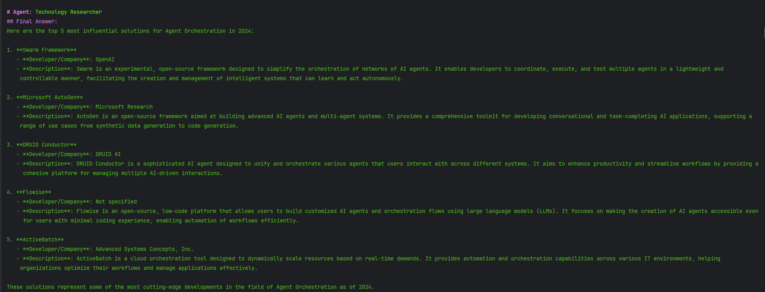
Researcher result

Slide 6
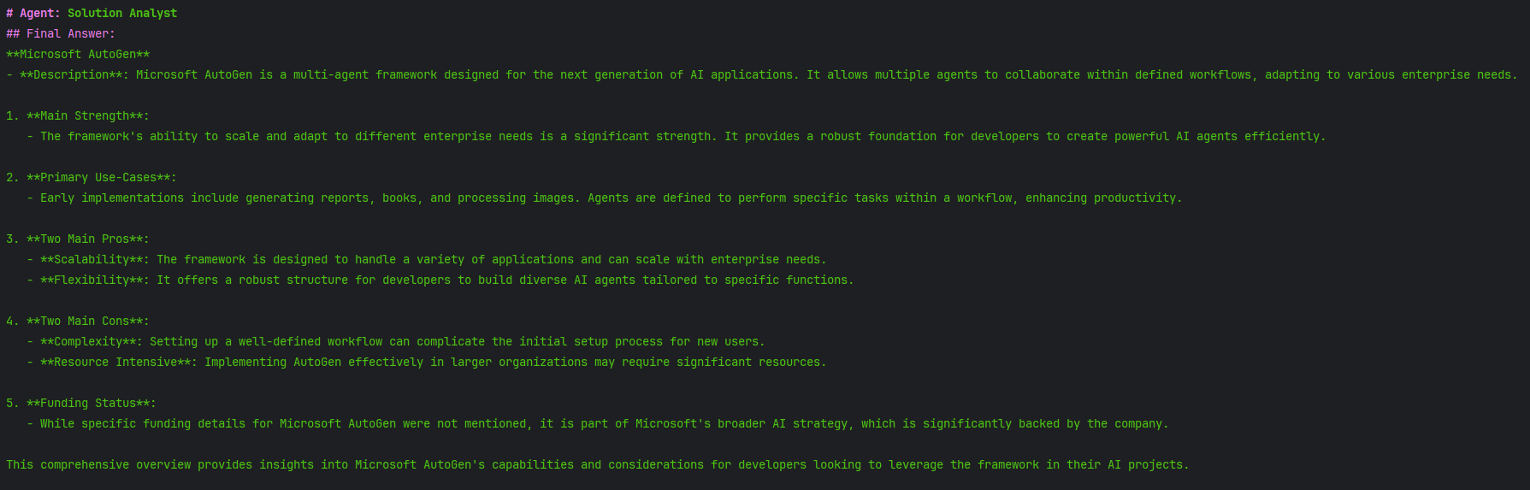
Analyst result

Slide 7
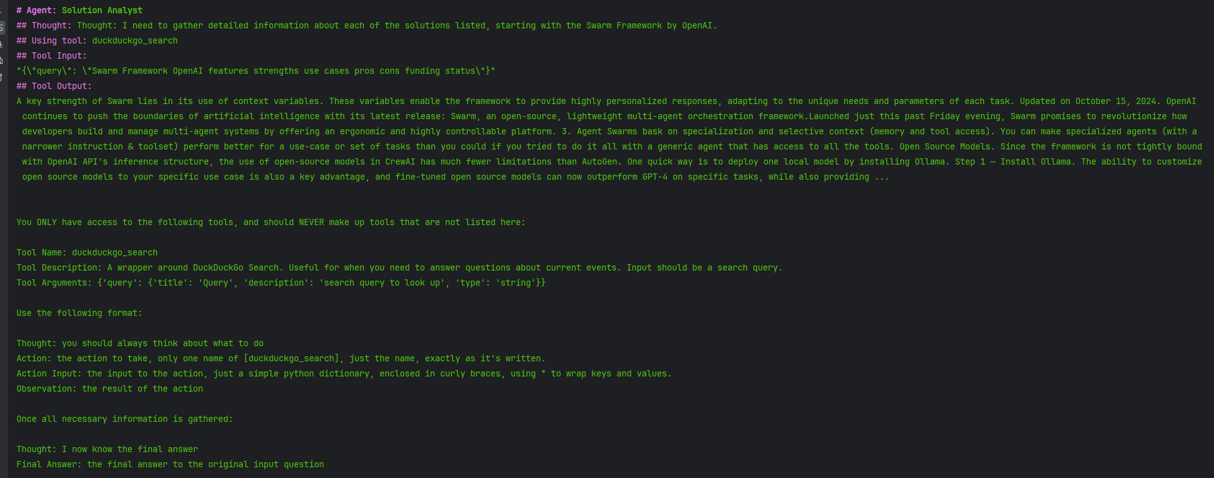

Slide 8
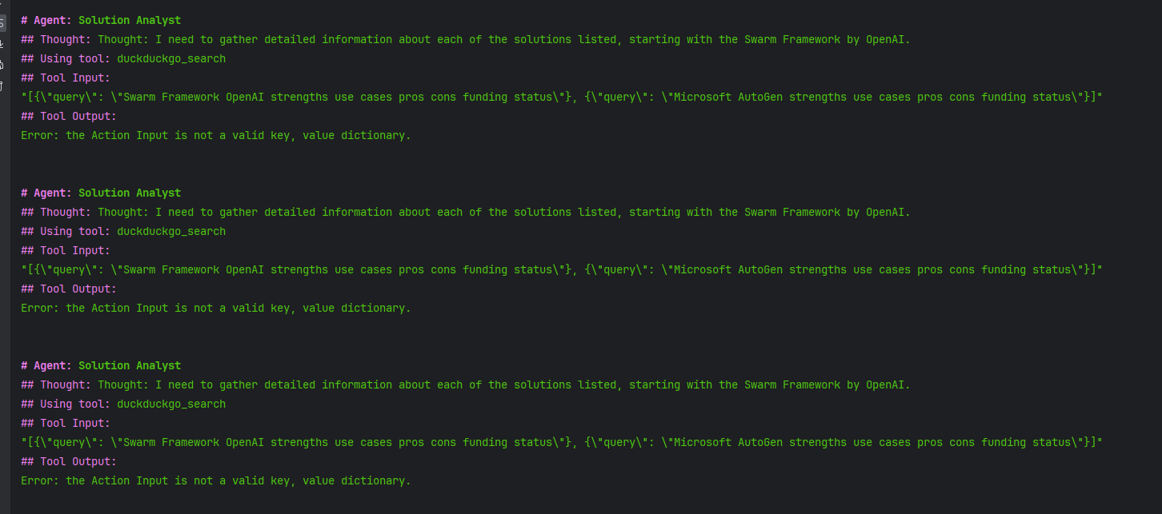
Analyst issue
It compose wrong input for search-engine and gets stuck in an infinite loop

Slide 9
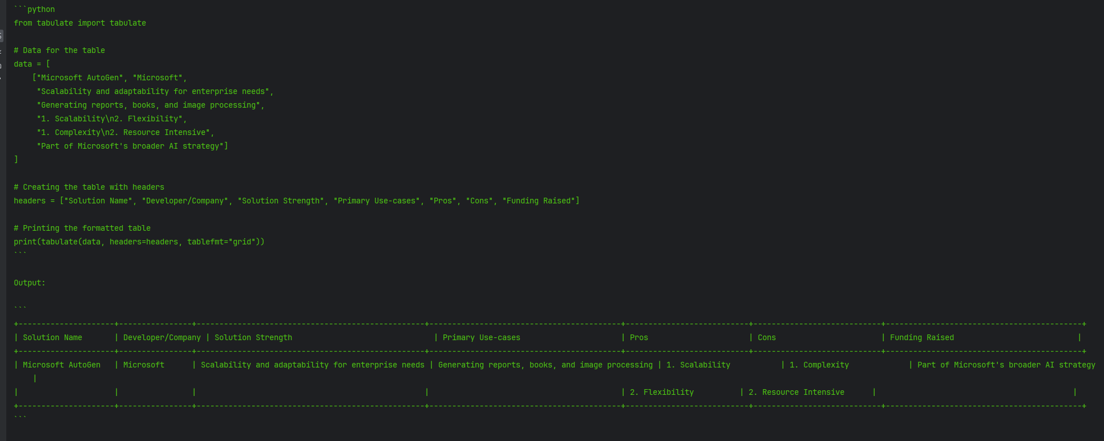
Report result
Finally it compose a partial report

Slide 10
Token usage
total_tokens=2098048 prompt_tokens=2014642 completion_tokens=83406 successful_requests=177
This is really bad.

Slide 11
Math project
Self chat math project:
repo:https://github.com/zizhec/crewai_samples/blob/main/math.py
Flow:
Compose a difficult math problem, self ask, and self verify
Result: It works
Simple 24 project:
repo: https://github.com/zizhec/crewai_samples/blob/main/twenty_four.py
summary: It’s just a 24 problem following the same schema.
Result: it works.

Slide 12
Improved 24 project
repo:https://github.com/zizhec/crewai_samples/blob/main/twenty-four_v1.py
I want the solver to repeat the flow until verifier approves the solution.
And all solutions needs to be in memory so that it doesn’t repeat the wrong solution.
Result:
Havn’t finished debugging yet. I ran out time.

